Slide 1
Alternative Visualization Dashboard for the Park Management
File created on: 23/02/2024 08:14:15

Slide 2
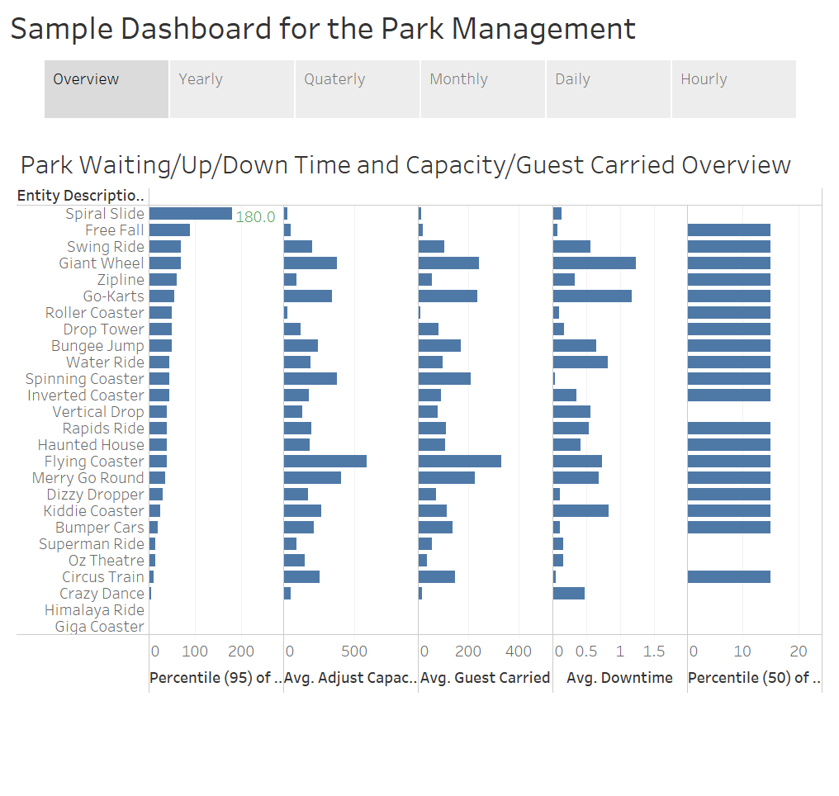

Slide 3
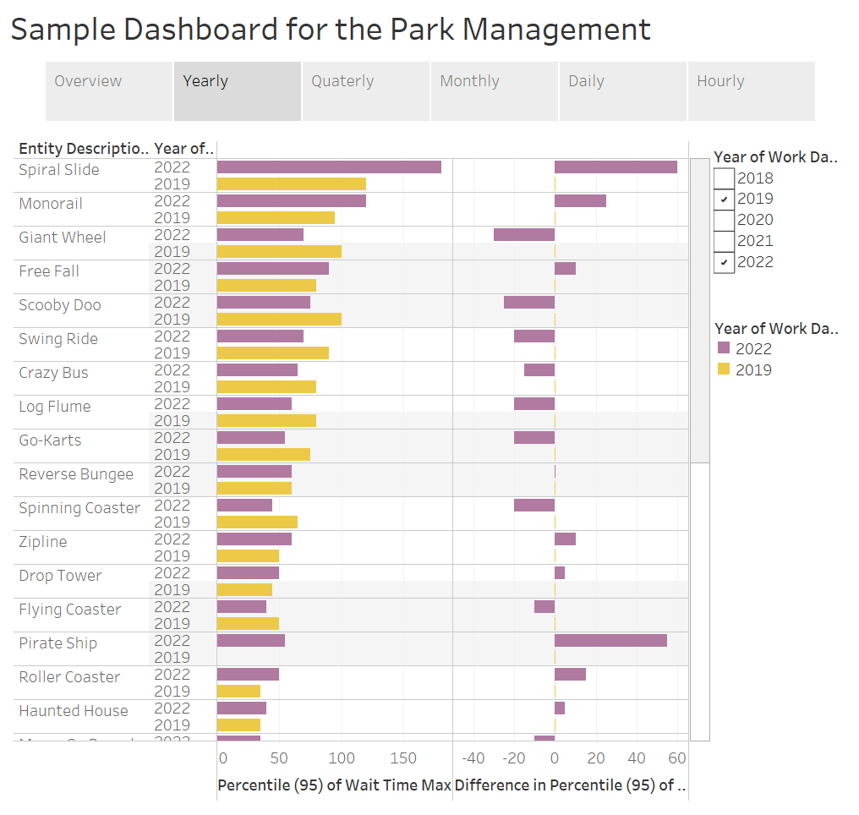

Slide 4
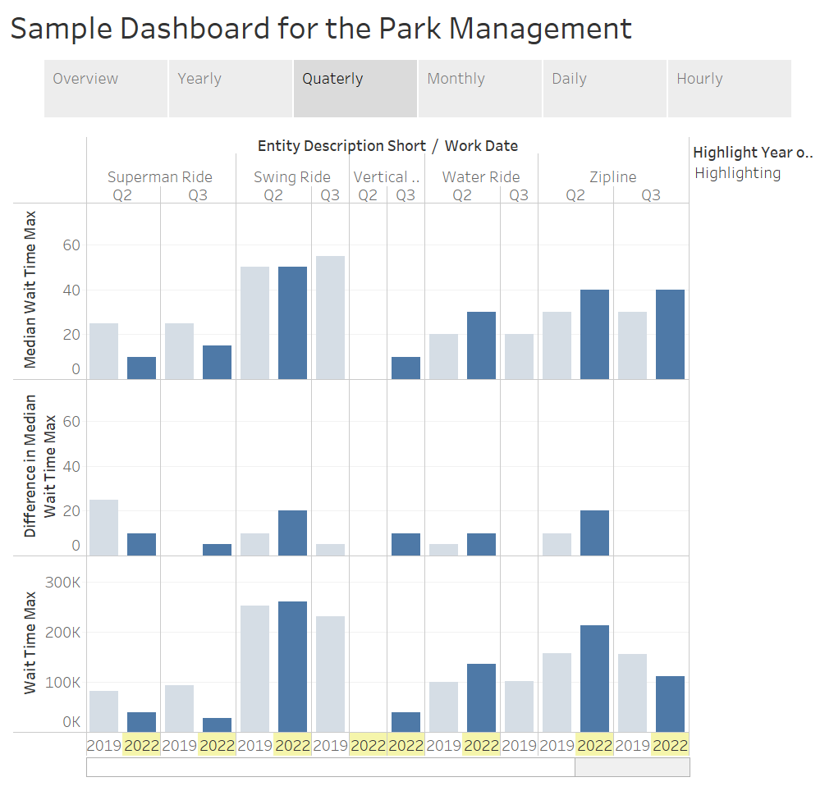

Slide 5
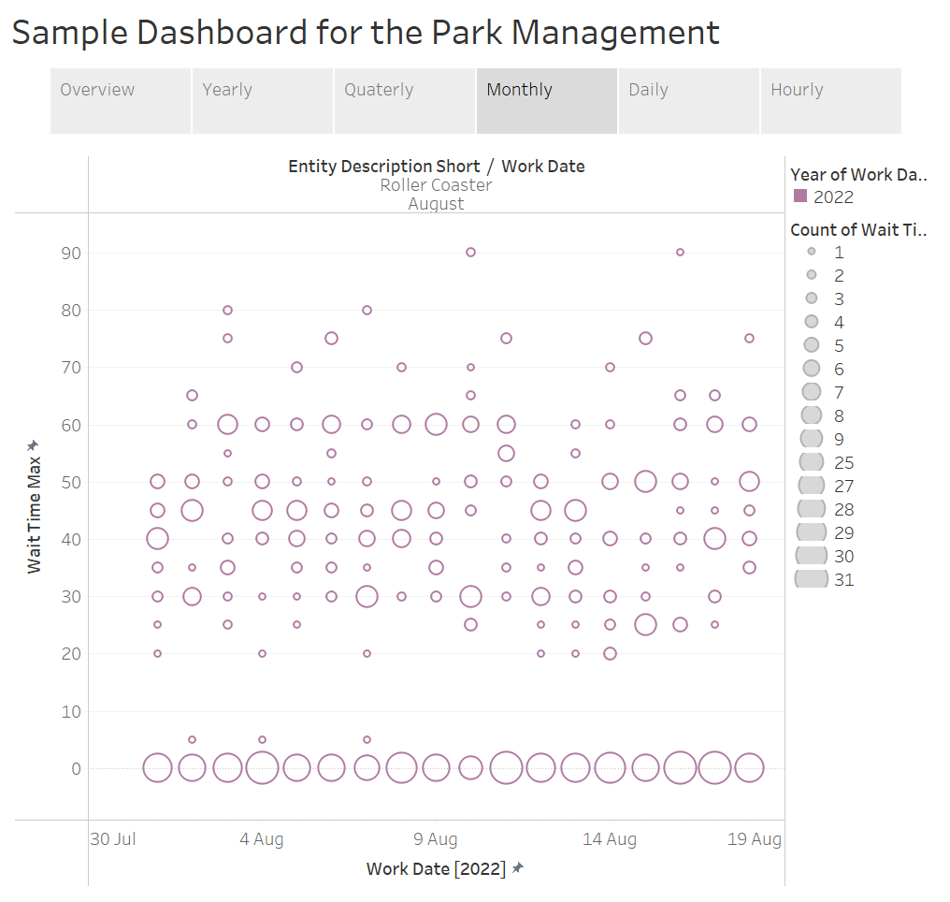

Slide 6
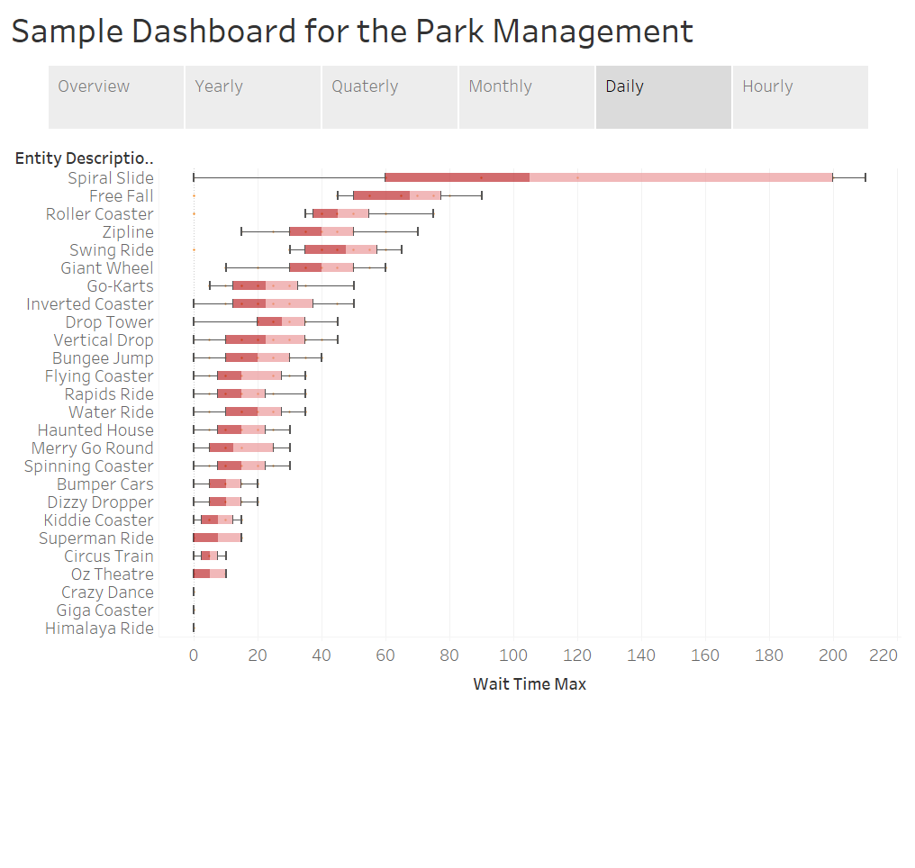

Slide 7
